Slide 1
Chapter 4
Lexical and Syntax Analysis

Slide 2
Chapter 4 Topics
Introduction
Lexical Analysis
The Parsing Problem
Recursive-Descent Parsing
Bottom-Up Parsing
Copyright © 2012 Addison-Wesley. All rights reserved.
1-<number>

Slide 3
Recursive-Descent Parsing
There is a subprogram for each nonterminal in the grammar, which can parse sentences that can be generated by that nonterminal
EBNF is ideally suited for being the basis for a recursive-descent parser, because EBNF minimizes the number of nonterminals
Copyright © 2012 Addison-Wesley. All rights reserved.
1-<number>

Slide 4
Recursive-Descent Parsing (continued)
A grammar for simple expressions:
<expr> → <term> {(+ | -) <term>}
<term> → <factor> {(* | /) <factor>}
<factor> → id | int_constant | ( <expr> )
Copyright © 2012 Addison-Wesley. All rights reserved.
1-<number>

Slide 5
Recursive-Descent Parsing (continued)
Assume we have a lexical analyzer named lex, which puts the next token code in nextToken
The coding process when there is only one RHS:
  For each terminal symbol in the RHS, compare it with the next input token; if they match, continue, else there is an error
  For each nonterminal symbol in the RHS, call its associated parsing subprogram
Copyright © 2012 Addison-Wesley. All rights reserved.
1-<number>

Slide 6
Recursive-Descent Parsing (continued)
/* Function expr
Parses strings in the language
generated by the rule:
<expr> → <term> {(+ | -) <term>}
*/
void expr() {
/* Parse the first term */
term();
/* As long as the next token is + or -, call
lex to get the next token and parse the
next term */
while (nextToken == ADD_OP ||
nextToken == SUB_OP){
lex();
term();
}
}
Copyright © 2012 Addison-Wesley. All rights reserved.
1-<number>

Slide 7
Recursive-Descent Parsing (continued)
This particular routine does not detect errors
Convention: Every parsing routine leaves the next token in nextToken
Copyright © 2012 Addison-Wesley. All rights reserved.
1-<number>

Slide 8
Recursive-Descent Parsing (continued)
A nonterminal that has more than one RHS requires an initial process to determine which RHS it is to parse
  The correct RHS is chosen on the basis of the next token of input (the lookahead)
  The next token is compared with the first token that can be generated by each RHS until a match is found
  If no match is found, it is a syntax error
Copyright © 2012 Addison-Wesley. All rights reserved.
1-<number>

Slide 9
Recursive-Descent Parsing (continued)
/* term
Parses strings in the language generated by the rule:
<term> -> <factor> {(* | /) <factor>)
*/
void term() {
/* Parse the first factor */
factor();
/* As long as the next token is * or /,
next token and parse the next factor */
while (nextToken == MULT_OP || nextToken == DIV_OP) {
lex();
factor();
}
} /* End of function term */
Copyright © 2012 Addison-Wesley. All rights reserved.
1-<number>

Slide 10
Recursive-Descent Parsing (continued)
/* Function factor
Parses strings in the language
generated by the rule:
<factor> -> id | (<expr>) */
void factor() {
/* Determine which RHS */
if (nextToken) == ID_CODE || nextToken == INT_CODE)
/* For the RHS id, just call lex */
lex();
/* If the RHS is (<expr>) – call lex to pass over the left parenthesis,
call expr, and check for the right parenthesis */
else if (nextToken == LP_CODE) {
lex();
expr();
if (nextToken == RP_CODE)
lex();
else
error();
} /* End of else if (nextToken == ... */
else error(); /* Neither RHS matches */
}
Copyright © 2012 Addison-Wesley. All rights reserved.
1-<number>

Slide 11
Recursive-Descent Parsing (continued)
- Trace of the lexical and syntax analyzers on (sum + 47) / total
Next token is: 25 Next lexeme is ( Next token is: 11 Next lexeme is total
Enter <expr> Enter <factor>
Enter <term> Next token is: -1 Next lexeme is EOF
Enter <factor> Exit <factor>
Next token is: 11 Next lexeme is sum Exit <term>
Enter <expr> Exit <expr>
Enter <term>
Enter <factor>
Next token is: 21 Next lexeme is +
Exit <factor>
Exit <term>
Next token is: 10 Next lexeme is 47
Enter <term>
Enter <factor>
Next token is: 26 Next lexeme is )
Exit <factor>
Exit <term>
Exit <expr>
Next token is: 24 Next lexeme is /
Exit <factor>
Copyright © 2012 Addison-Wesley. All rights reserved.
1-<number>

Slide 12
Recursive-Descent Parsing (continued)
The LL Grammar Class
  The Left Recursion Problem
    If a grammar has left recursion, either direct or indirect, it cannot be the basis for a top-down parser
      A grammar can be modified to remove direct left recursion as follows:
      For each nonterminal, A,
      Group the A-rules as A → Aα₁ | … | Aα_{m} | β₁ | β₂ | … | β_{n}
      where none of the β‘s begins with A
      2. Replace the original A-rules with
      A → β₁A’ | β₂A’ | … | β_{n}A’
      A’ → α₁A’ | α₂A’ | … | α_{m}A’ | ε
Copyright © 2012 Addison-Wesley. All rights reserved.
1-<number>

Slide 13
Recursive-Descent Parsing (continued)
The other characteristic of grammars that disallows top-down parsing is the lack of pairwise disjointness
  The inability to determine the correct RHS on the basis of one token of lookahead
  Def: FIRST(α) = {a | α =>* aβ }
(If α =>* ε, ε is in FIRST(α))
Copyright © 2012 Addison-Wesley. All rights reserved.
1-<number>

Slide 14
Recursive-Descent Parsing (continued)
Pairwise Disjointness Test:
  For each nonterminal, A, in the grammar that has more than one RHS, for each pair of rules, A → α_{i} and A → α_{j}, it must be true that
FIRST(α_{i}) ⋂ FIRST(α_{j}) = φ
Example:
A → a | bB | cAb
A → a | aB
Copyright © 2012 Addison-Wesley. All rights reserved.
1-<number>

Slide 15
Recursive-Descent Parsing (continued)
Left factoring can resolve the problem
Replace
<variable> → identifier | identifier [<expression>]
with
<variable> → identifier <new>
<new> → ε | [<expression>]
or
<variable> → identifier [[<expression>]]
(the outer brackets are metasymbols of EBNF)
Copyright © 2012 Addison-Wesley. All rights reserved.
1-<number>

Slide 16
Bottom-up Parsing
The parsing problem is finding the correct RHS in a right-sentential form to reduce to get the previous right-sentential form in the derivation
Copyright © 2012 Addison-Wesley. All rights reserved.
1-<number>

Slide 17
Bottom-up Parsing (continued)
Intuition about handles:
  Def: β is the handle of the right sentential form
γ = αβw if and only if S =>*_{rm} αAw =>_{rm} αβw
  Def: β is a phrase of the right sentential form
γ if and only if S =>* γ = α₁Aα₂ =>+ α₁βα₂
  Def: β is a simple phrase of the right sentential form γ if and only if S =>* γ = α₁Aα₂ => α₁βα₂
Copyright © 2012 Addison-Wesley. All rights reserved.
1-<number>

Slide 18
Bottom-up Parsing (continued)
Intuition about handles (continued):
  The handle of a right sentential form is its leftmost simple phrase
  Given a parse tree, it is now easy to find the handle
  Parsing can be thought of as handle pruning
Copyright © 2012 Addison-Wesley. All rights reserved.
1-<number>

Slide 19
Bottom-up Parsing (continued)
Shift-Reduce Algorithms
  Reduce is the action of replacing the handle on the top of the parse stack with its corresponding LHS
  Shift is the action of moving the next token to the top of the parse stack
Copyright © 2012 Addison-Wesley. All rights reserved.
1-<number>

Slide 20
Bottom-up Parsing (continued)
Advantages of LR parsers:
  They will work for nearly all grammars that describe programming languages.
  They work on a larger class of grammars than other bottom-up algorithms, but are as efficient as any other bottom-up parser.
  They can detect syntax errors as soon as it is possible.
  The LR class of grammars is a superset of the class parsable by LL parsers.
Copyright © 2012 Addison-Wesley. All rights reserved.
1-<number>

Slide 21
Bottom-up Parsing (continued)
LR parsers must be constructed with a tool
Knuth’s insight: A bottom-up parser could use the entire history of the parse, up to the current point, to make parsing decisions
  There are only a finite and relatively small number of different parse situations that could have occurred, so the history could be stored in a parser state, on the parse stack
Copyright © 2012 Addison-Wesley. All rights reserved.
1-<number>

Slide 22
Bottom-up Parsing (continued)
An LR configuration stores the state of an LR parser
(S₀X₁S₁X₂S₂…X_{m}S_{m}, a_{i}a_{i+1}…a_{n}$)
Copyright © 2012 Addison-Wesley. All rights reserved.
1-<number>

Slide 23
Bottom-up Parsing (continued)
LR parsers are table driven, where the table has two components, an ACTION table and a GOTO table
  The ACTION table specifies the action of the parser, given the parser state and the next token
    Rows are state names; columns are terminals
  The GOTO table specifies which state to put on top of the parse stack after a reduction action is done
    Rows are state names; columns are nonterminals
Copyright © 2012 Addison-Wesley. All rights reserved.
1-<number>

Slide 24

Structure of An LR Parser
Copyright © 2012 Addison-Wesley. All rights reserved.
1-<number>

Slide 25
Bottom-up Parsing (continued)
Initial configuration: (S₀, a₁…a_{n}$)
Parser actions:
  For a Shift, the next symbol of input is pushed onto the stack, along with the state symbol that is part of the Shift specification in the Action table
  For a Reduce, remove the handle from the stack, along with its state symbols. Push the LHS of the rule. Push the state symbol from the GOTO table, using the state symbol just below the new LHS in the stack and the LHS of the new rule as the row and column into the GOTO table
Copyright © 2012 Addison-Wesley. All rights reserved.
1-<number>

Slide 26
Bottom-up Parsing (continued)
Parser actions (continued):
  For an Accept, the parse is complete and no errors were found.
  For an Error, the parser calls an error-handling routine.
Copyright © 2012 Addison-Wesley. All rights reserved.
1-<number>

Slide 27
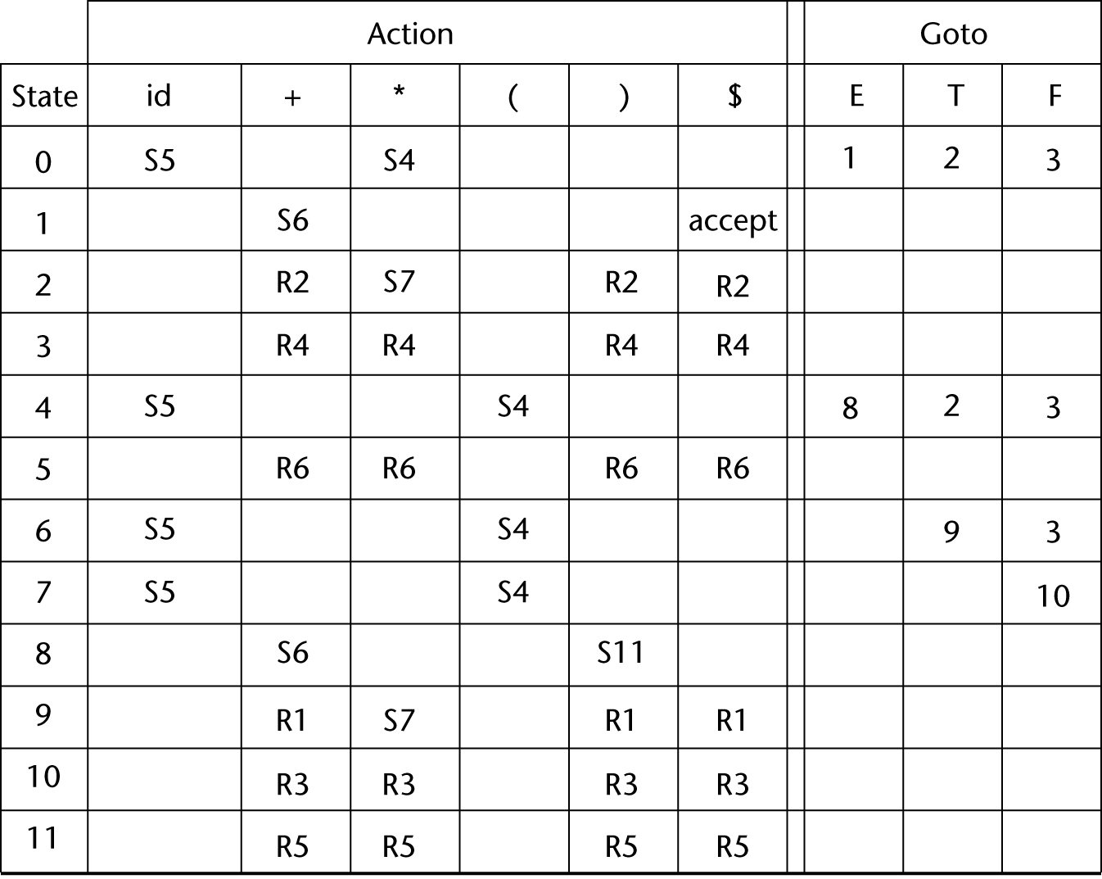
LR Parsing Table
Copyright © 2012 Addison-Wesley. All rights reserved.
1-<number>

Slide 28
Bottom-up Parsing (continued)
A parser table can be generated from a given grammar with a tool, e.g., yacc or bison
Copyright © 2012 Addison-Wesley. All rights reserved.
1-<number>

Slide 29
Summary
Syntax analysis is a common part of language implementation
A lexical analyzer is a pattern matcher that isolates small-scale parts of a program
  Detects syntax errors
  Produces a parse tree
A recursive-descent parser is an LL parser
  EBNF
Parsing problem for bottom-up parsers: find the substring of current sentential form
The LR family of shift-reduce parsers is the most common bottom-up parsing approach
Copyright © 2012 Addison-Wesley. All rights reserved.
1-<number>

